Slide 1


Polarization and interference
Fedir Uleshchenko, Oles Hordiichuk

Slide 2
Goals
The main goals of this project were:
Collect circular polarization setup and calibrate it to the maximum possible
Create an interferometer and take a photo of the interference

Slide 3
A little theory

Slide 4
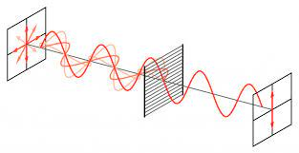
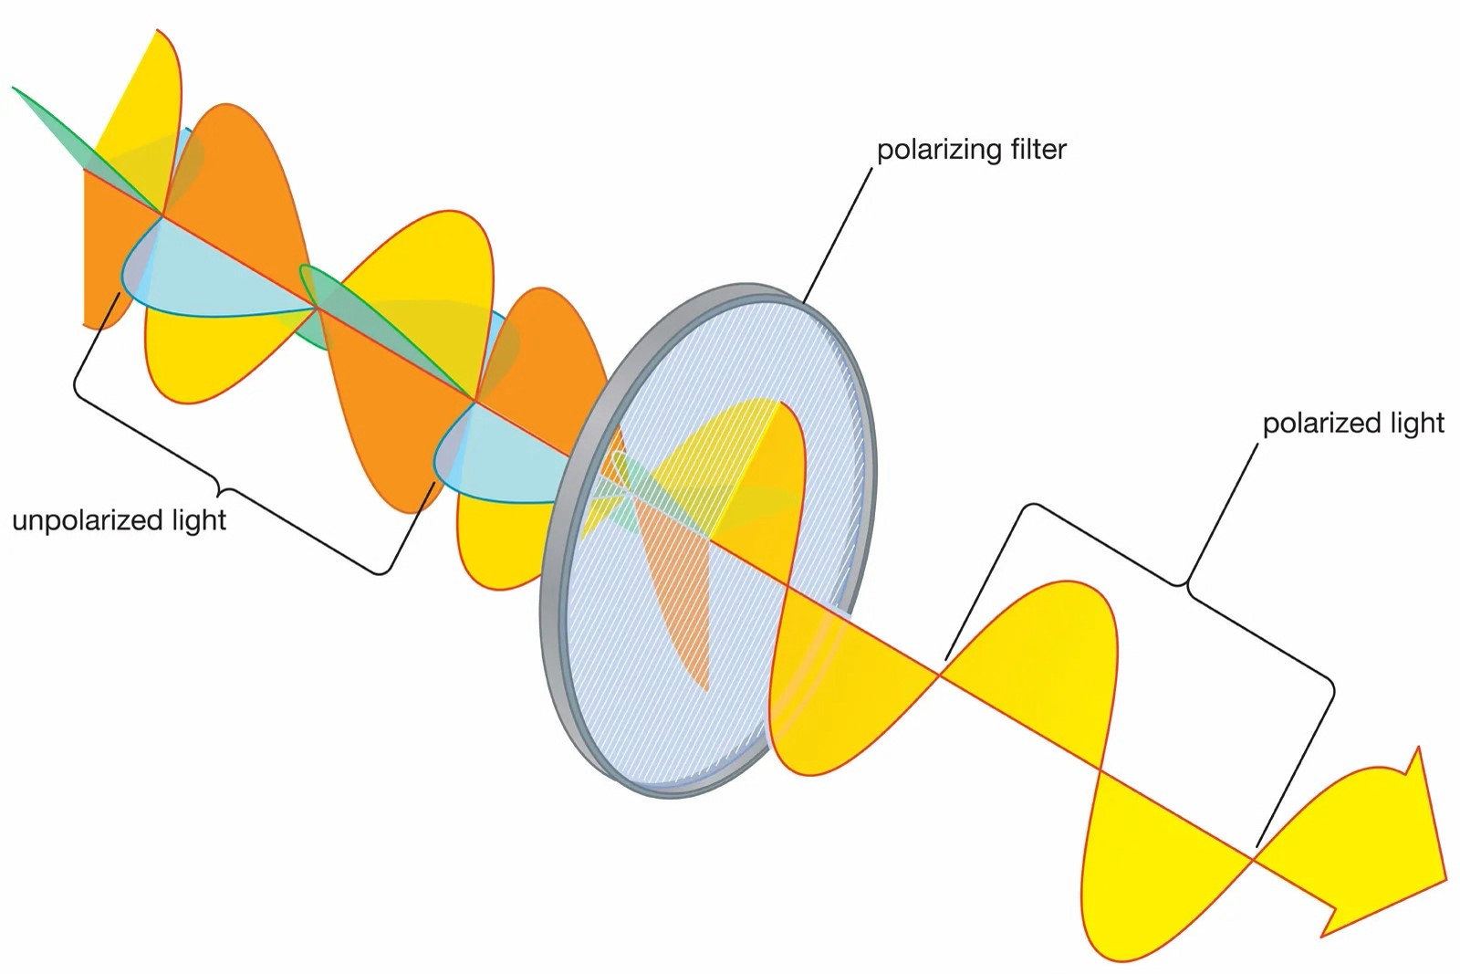
What is polarization?
As we know, pure light consists of waves that oscillate in different planes.
Polarization is the selection of oscillations in a transverse wave in only one plane (or only in certain planes).

Slide 5
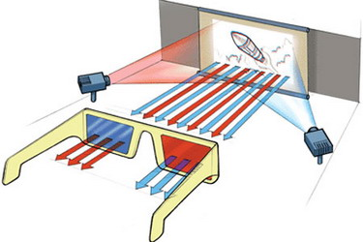
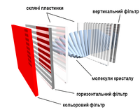
Where is it used?
Polarization is intended primarily to eliminate glare and rays in conditions of intense lighting. Polarizing filters are used to suppress specular reflections, for example, when photographing paintings, glass and porcelain products, water surfaces.
Polarization of electromagnetic waves and, in particular, light, is widely used in liquid crystal displays. Also, to create the effect of volume of the image in stereoscopic cinema.
Стереоскопічне кіно
Поляризація в рідкокристалічних дисплеях

Slide 6
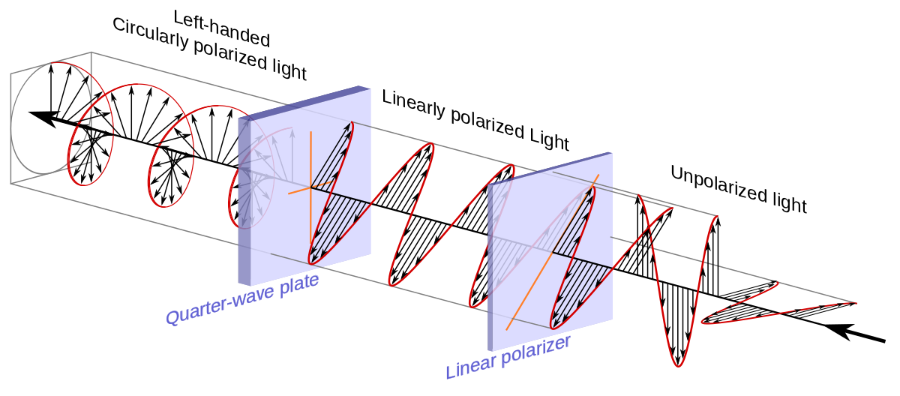
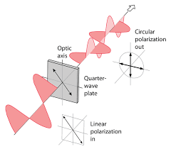
New types of oscillations
Waves can add, for example the phenomenon of resonance, when two waves are in antiphase or in phase. In fact, you can add waves from different planes. In this way, it is possible to create new types of oscillations, for example elliptical and circular. If polarization is performed by a device with the same name - a polarizer, then a Quarter Wave Plate is used to twist the wave. It can divide 1 wave into 2 and shift the phase of one by a quarter of a wavelength.

Slide 7
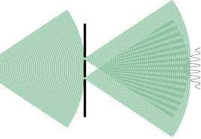
Interference
Wave interference - is the phenomenon of adding of two or more waves, resulting in an amplification of the final wave in some places (interference maximum), and a weakening in other places (interference minimum).

Slide 8
Use of interference
The use of light interference determines accurate measurements of wavelengths, small mechanical movements, diameters of stars, measurement of the refractive index of matter; study of physical processes, for example, stresses arising in matter under static and dynamic loads.
But there are also problems: modern precision optical devices have a large number of lenses, so even partial reflection of light on numerous surfaces significantly reduces the intensity of light that reaches the eye of the observer or the recording device. This is a big nuisance for astronomers and especially for the military: the light reflected from the lens ("glare") returns to the enemy, unmasking the location of the observation device.

Slide 9
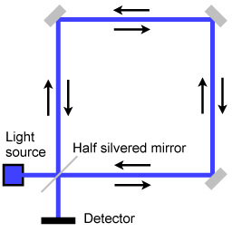
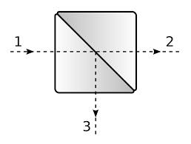
Sagnac interferometer
Our choice was the Sagnac interferometer. Its task is to split the beam into 2 beams with the help of a beam splitter, which then go through the same path. The phase shift occurs with the help of a half-wave plate, which shifts the wave by half its length.
Sagnac interferometer
Beam splitter

Slide 10
Results

Slide 11
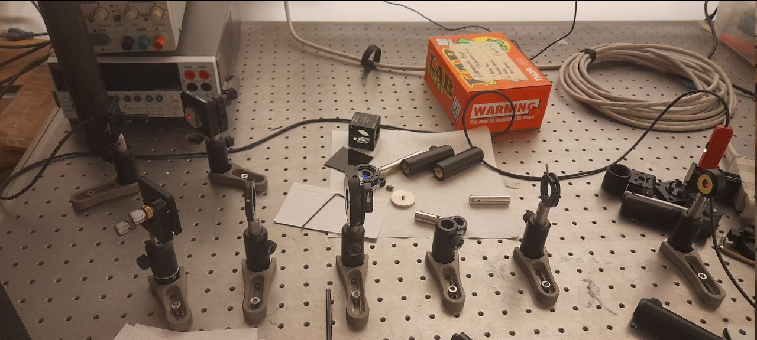
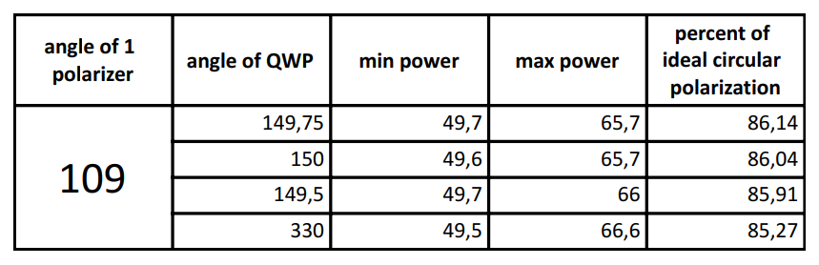
First task
Our first task was to build a device that would provide circular polarization as close to ideal as possible. It consisted of a first polarizer (so that the incoming waves have the same polarization), a quarter wave plate (to make a circular polarization) and a second polarizer (for verification). Here is the dependence of the quality of circular polarization on the angle of rotation of the quarter-wave plate:

Slide 12
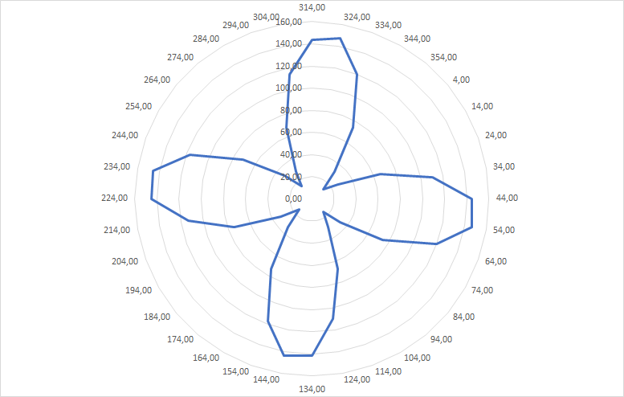
Second task
Our second task was to create a Sagnac interferometer and measure the dependence of the output energy on the angle of rotation of the half plate. This happens due to the change of phases, and therefore the change in the amount of energy that falls on the energy acceptor
Dependence of power on the HWP angle

Slide 13
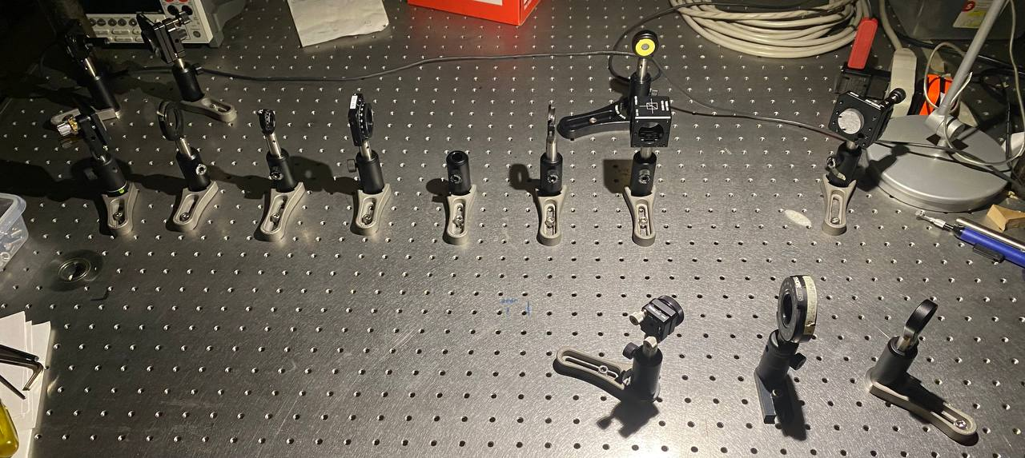
Final interferometer

Slide 14
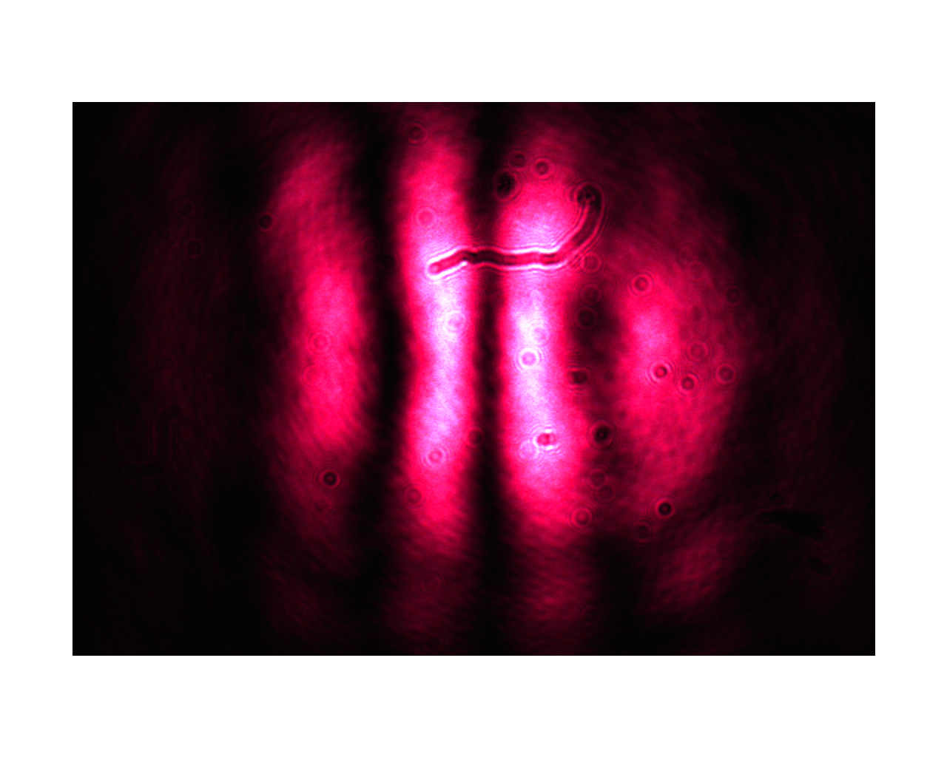
Interference received

